Slide 1


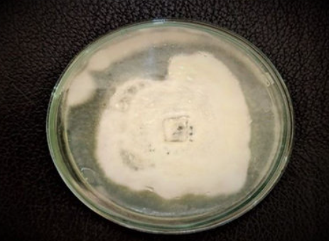

Hybrid Genome Assembly and Multi-Omics Analysis of Composting-Residue Isolates Reveal Bioplastic Degradation Potential
Martina Castellucci | A.Y. 2024/2025
MSc Bioinformatics
Applied Genomics Project
Notes:
Project idea: Compost-derived environments were sampled to obtain 20 fungal isolates with potential to degrade PLA/PHA. The goal is to screen their degradative ability, identify the most promising candidates, and select one isolate for in-depth genomic investigation (annotation, phylogenomic comparisons with non-degrading relatives, and transcriptomic profiling of candidate degradation genes).
Objective: To conduct a genetic study on a selected isolate as a basis for future bioengineering and synthetic biology applications. The broader aim is to develop fungal “biofactories” for large-scale bioplastic biodegradation, starting from novel isolates identified through this project.

Slide 2
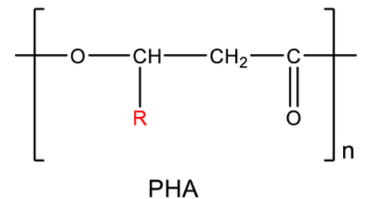
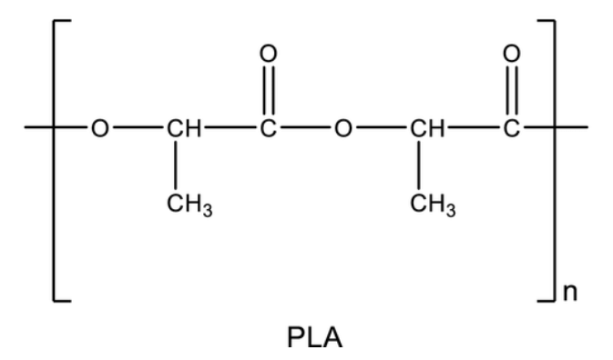



Scientific Context & Study Rationale
Polyhydroxyalkanoates
-Microbial polyester
-Bioplastics, medical
-Faster degradation
Polylactic Acid
Background
PLA & PHA: persistent bioplastics.
Fungi → hydrolytic enzymes (esterases, cutinases, lipases).
Compost = hotspot for degraders.
20 isolates; several active.
Rationale
Reveal genes & enzymes for degradation.
Integrate genome + transcriptome.
Basis for bioplastic valorization.
Goal
High-quality genome + RNA-Seq.
Link genotype ↔ expression.
Identify candidate enzymes.
-Plant polyester
-Packaging, biomedical
-Slow degradation
Notes:
Enzyme discovery: serves as the foundation for broader studies, including phylogenomic comparisons between PLA/PHA-degrading and non-degrading species, as well as synthetic biology approaches aimed at integrating key degradative genes into heterologous hosts.

Slide 3
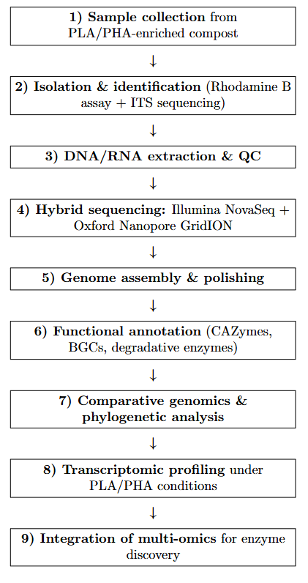









Research Workflow Overview
1
3
2
4
6
8
7
9
Notes:
We collected compost enriched in PLA/PHA and isolated around 20 fungal strains. After screening for degradative activity, we extracted DNA and RNA and applied hybrid sequencing for a high-quality genome assembly. Functional annotation focused on CAZymes and degradative enzymes, while comparative genomics and transcriptomics under plastic conditions highlighted candidate genes. Finally, integrating these multi-omics data provides the basis for enzyme discovery and potential biotechnological applications.

Slide 4
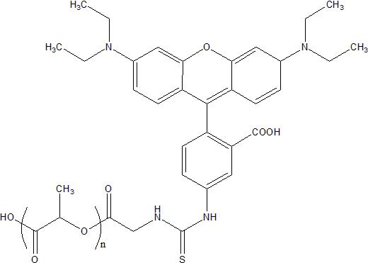
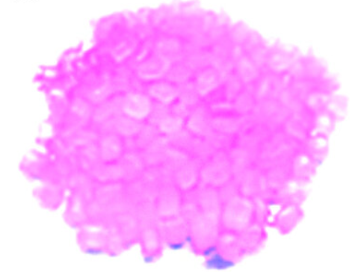
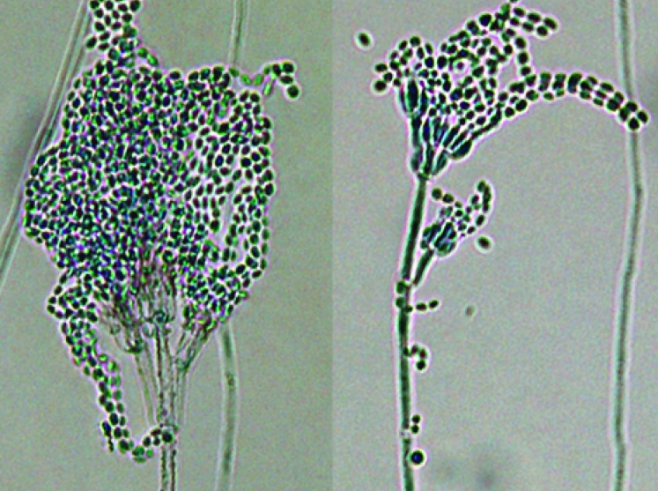
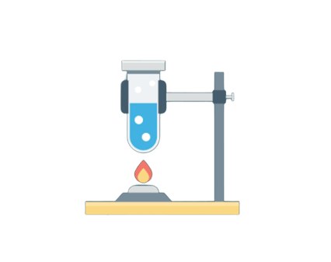
Collection and Identification
Compost from PLA/PHA-rich organic waste yielded 20 isolates; 5 were selected as PLA/PHA degraders.
Cultured on PDA + 0.5% PLA + Rhodamine B
→ visible fluorescent halos = esterase activity.
Microscopy showed septate hyphae with conidia, serving as the first step in taxonomic identification.
ITS rDNA sequencing confirmed species-level identity.
PLA granules coated with Rhodamine b
PLA-Rhodamine B –
Ruixibiotech
Notes:
We started by isolating 20 fungi from PLA/PHA-enriched compost and selected 5 based on Rhodamine B screening, where fluorescent halos indicated esterase activity.
Next, microscopy of the candidates revealed septate hyphae with conidia, supporting morphological identification.
Finally, ITS rDNA sequencing confirmed taxonomic assignment at species level.

Slide 5

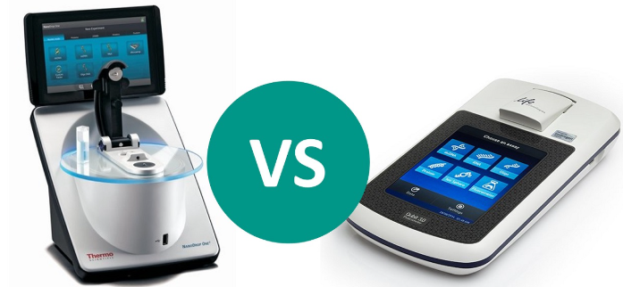
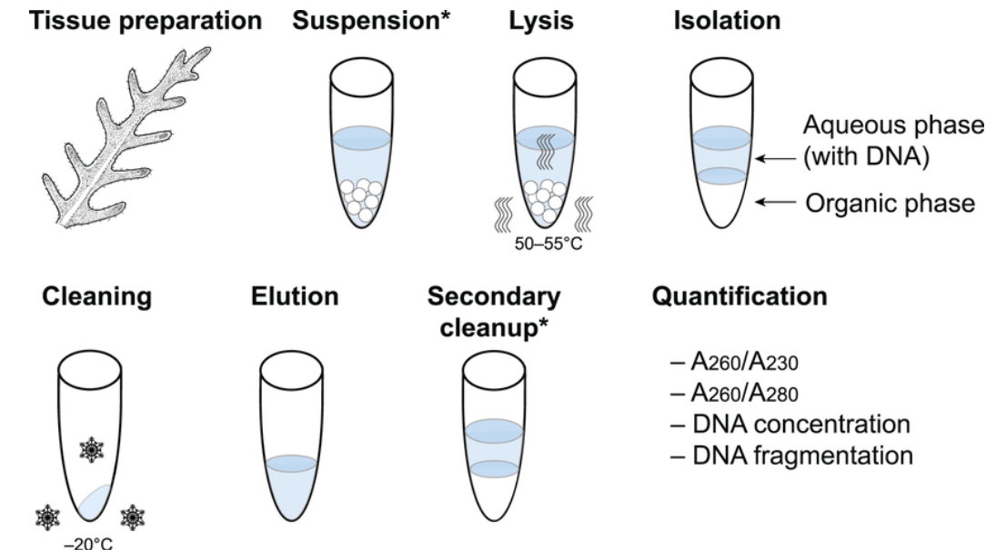

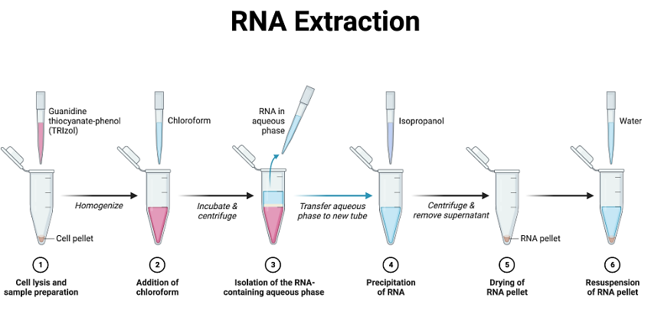
DNA Extraction & RNA Quality Control
Genomic DNA
CTAB extraction protocol → high-molecular-weight DNA (>20 kb).
QC: Qubit (yield), Nanodrop (purity), gel electrophoresis (integrity).
Essential for Nanopore long-read sequencing.
Total RNA
Extraction: TRIzol + silica column purification.
QC: Bioanalyzer (RIN > 8), Nanodrop (A260/280).
Libraries: 12 RNA-Seq samples (Control, PLA, PHA, Blank × 3 replicates).
Ensures reliable transcriptome profiling.
Notes:
Genomic DNA: The CTAB protocol was selected because it yields high-molecular-weight DNA (>20 kb), which is essential for Nanopore sequencing. Quality control is performed with Qubit (concentration), Nanodrop (purity ratios), and gel electrophoresis (integrity). This ensures long reads with minimal fragmentation.
RNA Extraction: TRIzol combined with silica columns provides clean, high-integrity RNA. Bioanalyzer values above RIN 8 confirm transcript integrity. Nanodrop is used to check A260/280 purity.
RNA-Seq Design: A total of 12 libraries (Control, PLA, PHA, Blank × 3 replicates) are prepared, capturing transcriptional induction of degradative enzymes. High RNA quality is critical because degraded RNA would bias differential expression.
Key message: Proper extraction and QC ensure that both genome assembly (DNA) and RNA-Seq profiling (RNA) are robust, reproducible, and reliable for downstream bioinformatics.

Slide 6
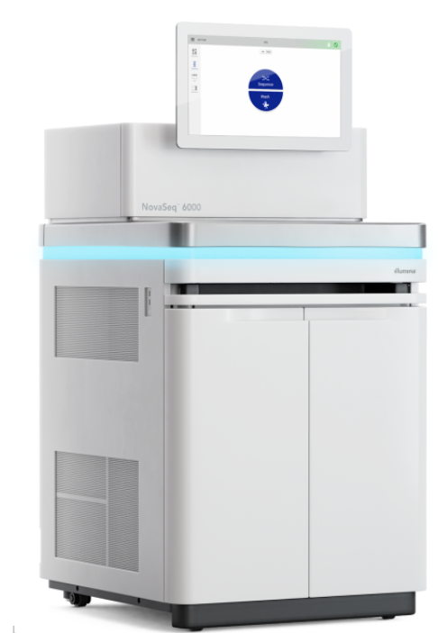
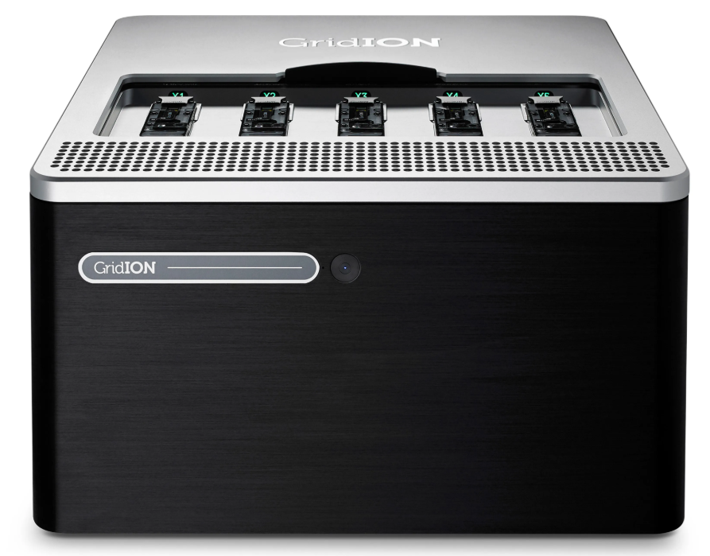

Hybrid Genome Sequencing Strategy
Illumina NovaSeq 6000
Oxford Nanopore GridION
Combine Illumina accuracy with Nanopore contiguity → polished, complete genome
Feature | Illumina NovaSeq 6000 | Oxford Nanopore GridION
Read type | Short, paired-end | Long, single-molecule
Read length | 150 bp (PE150) | Up to 20 kb
Coverage in project | ~101× | ~35×
Accuracy | >99.9% (Phred > Q30) | ~90–95% (after polishing)
Strengths | High base accuracy, SNP detection, RNA-Seq | Resolves repeats, structural variants, improves contiguity
Main role in project | Error correction, polishing, transcriptome mapping | Primary genome scaffolding, structural resolution
Notes:
Hybrid approach (theory-based advantage):
Illumina short reads → provide very high accuracy (99.9%), essential for polishing the genome, correcting base errors, and detecting small variants (SNPs, indels).
Nanopore long reads → span kilobases in a single read, resolving repeats, structural variants, and scaffolding the genome into larger, more contiguous assemblies.
Together → Illumina corrects the errors of Nanopore, while Nanopore compensates for the fragmentation of Illumina. This produces a genome that is both accurate and highly contiguous, outperforming either technology alone.

Slide 7
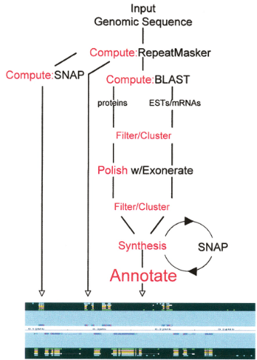
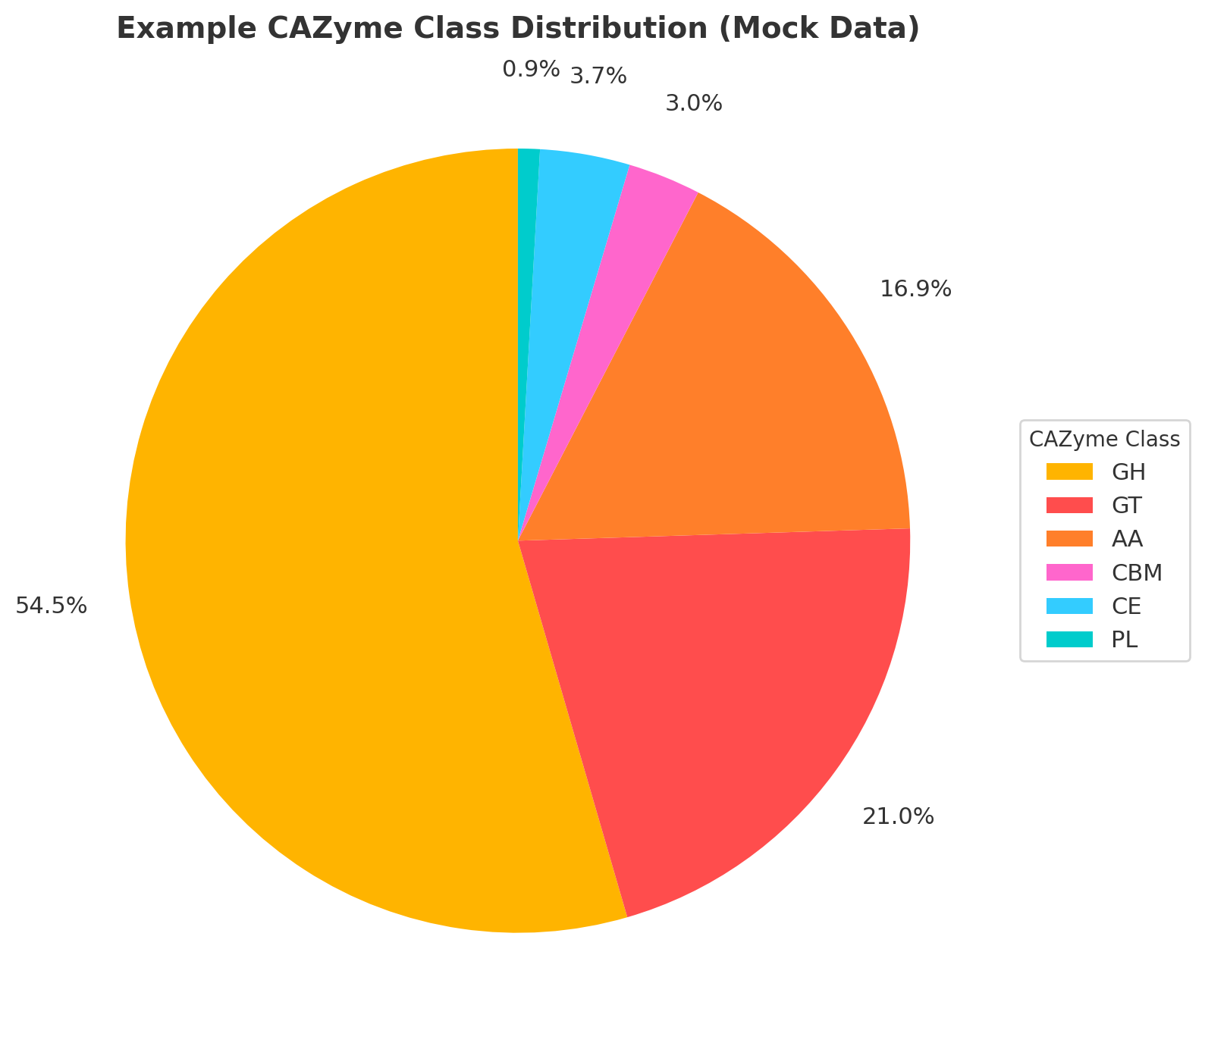


Hybrid Assembly & CAZyme Profile
Assembly & QC
Flye (Nanopore-first assembly) + Pilon (Illumina polishing)
QC: QUAST (contiguity), BUSCO >90% expected (completeness)
Annotation
MAKER3 pipeline (Augustus, GeneMark-ES)
RNA-Seq evidence for gene models
dbCAN3: CAZyme annotation
Geneious: manual curation
Expected Key Results
Genome assemblies: high contiguity + completeness
Broad CAZyme repertoire predicted, including:
Esterases
Cutinases
Lipases
MAKER Overview
Notes:
This phase is Genome assembly and functional annotation, focusing on CAZyme prediction.
The hybrid genome assembly (Illumina + Nanopore) provides a high-quality reference with long contigs and minimal gaps.
Annotation with RNA-seq support ensures accurate gene and enzyme prediction.
Among the predicted genes, CAZymes (Carbohydrate-Active Enzymes) are identified as key players in polymer degradation (e.g., esterases, cutinases, lipases).
This step enables pathway reconstruction, comparative/phylogenomic analyses, and gene gain/loss studies, linking genome data to functional and evolutionary insights.
→ In short, it’s where the raw genome turns into a functional enzyme map relevant for plastic degradation.

Slide 8
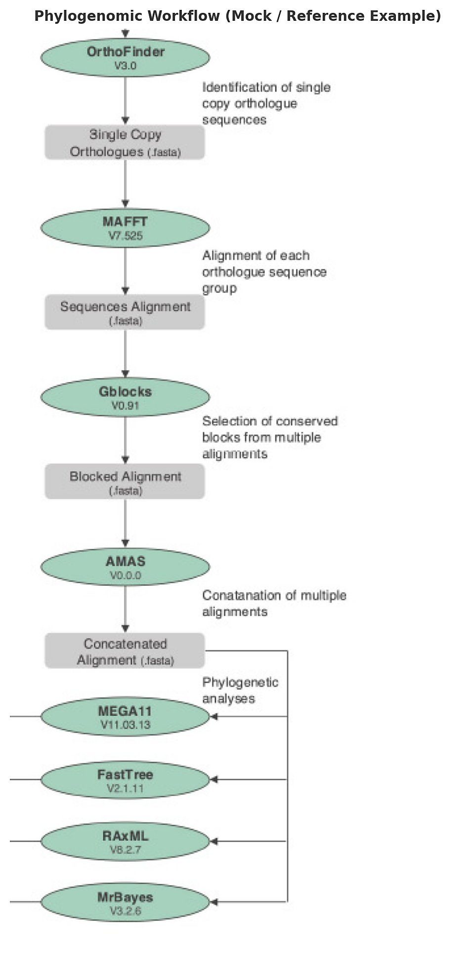
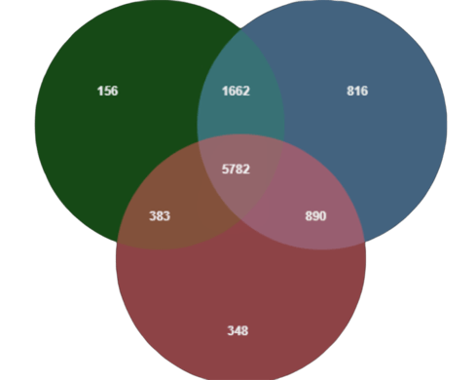



Genomic Comparison & Evolutionary Context
Approach →
Phylogenomics integrates degraders and non-degraders to resolve evolutionary placement. OrthoFinder identifies orthogroups, distinguishing shared vs unique genes. MCScanX / MAUVE assess genome collinearity, synteny, and structural rearrangements across related fungi.
Mock example jvenn (Orthofinder)
Expected Results:
- Unique orthogroups in degraders → candidate degradation genes.
- Synteny breaks / rearrangements linked to adaptation.
- Evolutionary placement of degraders within related fungi.
- Integration pinpoints gene clusters for PLA/PHA degradation.
Notes:
Why phylogenomics? Because it lets you place your isolates in an evolutionary framework. By comparing bioplastic-degrading vs. non-degrading fungi, you can statistically identify which genes or pathways are shared only among degraders. This gives strong candidates for essential degradation functions.
Why OrthoFinder & orthogroups? OrthoFinder groups genes into orthogroups across species. By comparing degraders vs. non-degraders, you can see which orthogroups are present only in degraders (gain) or missing in non-degraders (loss).
Why collinearity (MCScanX / Mauve)? Genome collinearity checks synteny and rearrangements. Structural differences can point to adaptive changes that might explain bioplastic degradation capacity.
Overall goal: To link genome evolution with function, highlighting candidate genes for PLA/PHA degradation that are statistically supported and evolutionarily conserved only in degraders.
→In short: Phylogenomics tells you who is related to whom and comparative genomics tells you what genes make degraders different from non-degraders.
Based on literature and preliminary surveys, several fungal groups are typically enriched in PLA/PHA-containing compost environments. Among Ascomycota, Aspergillus species are well known for their esterase activity and have been repeatedly reported as PLA degraders, while Fusarium produces cutinases and depolymerases relevant for polyester breakdown. Penicillium species possess a broad CAZyme repertoire, often overlapping with plastic-degrading enzymes, and Purpureocillium has been specifically documented for polyester degradation in addition to its biocontrol potential. Within Basidiomycota, white-rot fungi such as Phanerochaete chrysosporium and Trametes spp. contribute strong oxidative systems, including lignin peroxidases and laccases, that may also act on synthetic polymers. Finally, among Mucoromycota, Rhizopus species exhibit esterase activity and have been reported as opportunistic degraders. This simulated preview underlines the expectation that diverse fungal lineages, each with distinct enzymatic arsenals, may converge on the ability to depolymerize PLA/PHA materials.

Slide 9
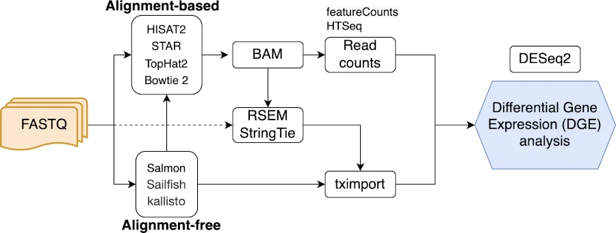
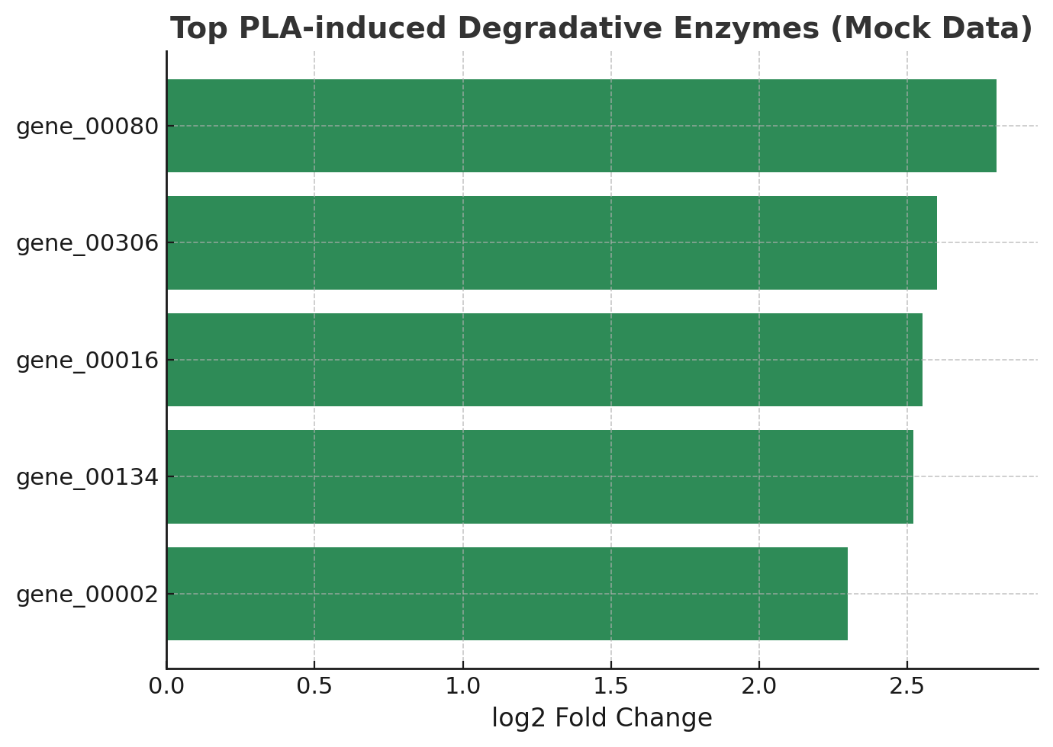
Gene Expression Response to Bioplastics
Transcriptomic Analysis
RNA-Seq design
12 libraries: Control, PLA, PHA, Blank × 3 replicates
PLA/PHA sampled at 12 h, 24 h, 36 h; Control = baseline
Quantification & DEG analysis
Salmon: transcript quantification
tximport: gene-level aggregation
DESeq2: DEG detection (FDR ≤ 0.05, |log₂FC| ≥ 2)
Thousands of DEGs identified, with plastic-specific signatures
Workflow for DGE analysis
Expected DEGs
PLA → ↑ cutinases, esterases, lipases
PHA → ↑ PHA depolymerase-like, lipases
Shared → ↑ oxidoreductases, transporters
Integration → overlap with CAZymes & orthogroups
Notes:
Static genome ≠ active function → The genome tells us what could be there, but only transcriptomics shows which genes are actually activated in response to PLA/PHA.
Dynamic regulation → By sampling across timepoints (12h, 24h, 36h), you capture how gene expression changes during the degradation process, revealing temporal activation patterns.
Prioritization of candidates → Among all annotated CAZymes and enzymes, transcriptomics highlights the subset that is truly upregulated when plastic is present.
Integration with phylogenomics → DEGs overlapping with orthogroup candidates strengthen the case for their role in plastic degradation.
→ In short: Transcriptomics filters the genome-wide enzyme repertoire down to the genes that are truly responsive and active during plastic degradation.
Shift metabolico dal controllo ricco di bioplastiche.

Slide 10

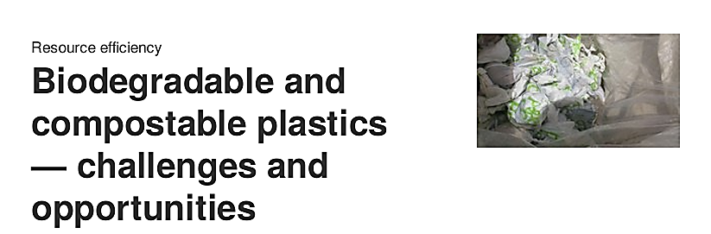

From Genome to Green Solutions
Strengths | Challenges
Targeted enzyme discovery enabling efficient PLA/PHA degradation | Scaling from lab to industrial composting facilities required
Multi-omics integration for mechanistic insights | Enzyme stability and efficiency under real environmental conditions
Alignment with EU Green Deal & Circular Economy Action Plan | Regulatory and safety assessments for field applications
Potential for industrial composting and waste valorization | Economic feasibility vs. conventional waste management
Creation of an open-access dataset for biotechnology R&D
European Environment Agency (2020).
EEA Briefing No. 09/2020.
DOI: 10.2800/552241
Notes:
to connect your genomics project to real-world applications:
Strengths: Our multi-omics pipeline allows targeted enzyme discovery for PLA/PHA degradation, aligns with EU Green Deal strategies, and supports industrial composting and waste valorization.
Challenges: The main hurdles are scaling from lab to industry, ensuring enzyme stability under real conditions, regulatory constraints, and proving economic feasibility against conventional waste management.
→In short: We provide the molecular tools for green solutions, but moving from genome to large-scale application requires overcoming industrial, regulatory, and economic barriers.

Slide 11

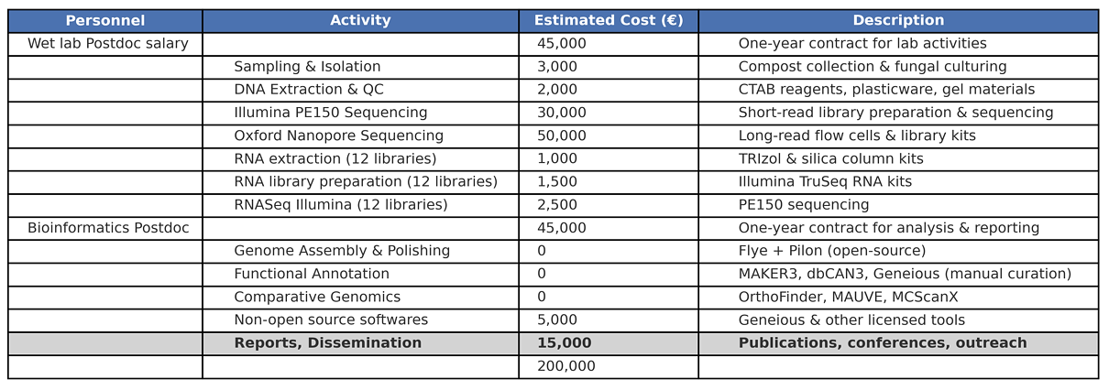
Estimated Project Budget
Project budget: €200,000
Notes:
Illumina sequencing is included to screen all isolates with high accuracy, while Nanopore long reads are essential to resolve repeats and generate contiguous hybrid assemblies. RNA-Seq with 12 libraries allows us to capture differential expression under PLA and PHA, highlighting the genes actually involved in degradation. Personnel costs cover one wet-lab and one bioinformatics postdoc to carry out both the experimental and computational parts. We also included extraction and QC materials to guarantee high-quality DNA and RNA, and a small budget for licensed software like Geneious to support annotation and visualization. Finally, dissemination ensures results can be published and presented at conferences. Each cost is therefore directly linked to a step of the pipeline, from sampling to functional enzyme discovery

Slide 12

Selected References & Tools
Scientific Articles
Menicucci, A., Iacono, S., Ramos, M., Fiorenzani, C., Peres, N. A., et al. (2025). Can whole genome sequencing resolve taxonomic ambiguities in fungi? The case study of Colletotrichum associated with ferns. Frontiers in Fungal Biology, 6, 1540469.
Ekanayaka, A. H. et al. (2025). Linking metabolic pathways to plastic-degrading fungi: a comprehensive review. J. Fungal Biol.
Prasad, P., Varshney, D., & Adholeya, A. (2015). Whole genome annotation and comparative genomic analyses of bio-control fungus Purpureocillium lilacinum. BMC Genomics, 16(1), 1004.
Main Tools Used
Assembly: Flye (long reads), Pilon (polishing with Illumina).
QC: QUAST + BUSCO (assembly completeness).
Annotation: MAKER3 (gene models, repeat masking), dbCAN3 (CAZyme annotation).
Comparative Genomics: OrthoFinder (orthogroups), MCScanX (synteny/collinearity).
Transcriptomics: Salmon (quantification), DESeq2 (DEG analysis).
Visualization: R / Python (plots), Geneious (manual curation).
Notes:
For assembly we used Flye with Nanopore reads, polished with Pilon using Illumina. Alternatives like Canu or SPAdes exist, but Flye is faster and optimized for long-read fungal genomes. For QC we selected QUAST and BUSCO since they are the standard for contiguity and completeness, although tools like Merqury could be used for k-mer validation. For annotation, MAKER3 was chosen because it integrates transcriptomic evidence, while alternatives like AUGUSTUS or BRAKER2 are less flexible. CAZymes were annotated with dbCAN3, which is the reference tool for carbohydrate-active enzymes. In comparative genomics, we used OrthoFinder and MCScanX for orthogroups and synteny; alternatives like OrthoMCL or SyMAP exist but are less scalable. For transcriptomics, Salmon and DESeq2 were chosen for fast quantification and robust DEG analysis, although alternatives like Kallisto or edgeR are available. Finally, for visualization we combined R/Python with Geneious, chosen for its user-friendly interface, even though command-line options like IGV are also common.

